Slide 1


Chapter 4: Spanning Tree in Depth
CCNP SWITCH v7.1: Implementing Cisco IP Switched Networks

Slide 2

Spanning Tree Protocol Overview

Slide 3
The Need for STP
Redundant topology can eliminate single points of failure in the network , however, STP blocks certain ports, so there is only one active path to each segment.

Slide 4
Redundant Topology Problems
Broadcast storms
Each switch on a redundant network floods broadcast frames endlessly. These frames then travel around the loop in all directions.
Multiple frame transmission
Multiple copies of the same unicast frames may be delivered to destination station, which can cause problems with the receiving protocol.
Multiple copies of the same frame can cause unrecoverable errors.
MAC database instability
If a loop occurs, the same source MAC address could be seen on multiple interfaces causing instability.
Data forwarding can be impaired when the switch consumes the resources that are coping with instability in the MAC address table.

Slide 5
Solution
STP allows physical path redundancy while preventing the undesirable effects of active loops in the network.
STP forces certain ports into a standby state so that they do not listen, forward, or flood data frames.
There is only one active path to each network segment.
If there is a problem with connectivity to any of the segments, STP reestablishes connectivity by automatically activating a previously inactive path.
STP uses bridge protocol data units (BPDUs) for its operations.
Notes:
BPDUs are messages that STP uses to determine current topology information and how to react if any devices added or removed or changed in the topology. By default they are sent out every 2 seconds on all switch ports. BDPUs are discussed later in detail.

Slide 6
STP Standards
Spanning-tree varieties that use more than one instance of STP have a higher CPU and memory requirements
CPU and memory requirements are also higher when spanning-tree protocols with faster convergence are used because the algorithm needs to make calculations more frequently

Slide 7
STP Decision Sequence
When creating a loop-free topology, STP always uses the same four-step decision sequence:
Four-Step decision Sequence
Step 1 - Lowest BID
Step 2 - Lowest Path Cost to Root Bridge
Step 3 - Lowest Sender BID
Step 4 - Lowest Sender Port ID

Slide 8
STP Operations
STP provides loop resolution by managing the physical path to the given network segment, by performing the following four steps:
Elects one root bridge
Only one bridge can act as the root bridge. The root bridge is the reference point; all data flows in the network are from the perspective of this switch. All ports on a root bridge are forwarding traffic.
Selects the root port on the nonroot bridge
One port on each nonroot bridge is the root port. It is the port with the lowest-cost path from the nonroot bridge to the root bridge. By default, STP path cost is calculated from the bandwidth of the link. You can also set STP path cost manually.
Selects the designated port on each segment
There is one designated port on each segment. It is selected on the bridge with the lowest-cost path to the root bridge.
Block all remaining ports:
Ports that are NOT designated or Root must be nondesignated. These ports are normally in the blocking state to break the loop topology

Slide 9
STP Port Roles

Slide 10
Bridge Protocol Data Units
STP uses BPDUs to exchange STP information, specifically for root bridge election and for loop identification
By default, BPDUs sent out every 2 seconds, with the destination STP Multicast address 01-80-c2-00-00-00
Two Types
Configuration BPDUs:
Used for calculation the STP
TCN (topology change notification):
Used to inform changes in the network.

Slide 11
The BPDU Frame
Protocol ID: Identifies the STP
Version: Identifies the current version of the protocol
Message Type: Identifies the type of BPDU (configuration or TCN BPDU)
Flags: Used in response to a TCN BPDU
Root Bridge ID: Identifies the bridge ID (BID) of the root bridge
Root Path Cost: Identifies the cost from the transmitting switch to the root
Sender Bridge ID: Identifies the BID of the transmitting switch
Port ID: Identifies the transmitting port
Message Age: Indicates the age of the current BPDU
Max Age: Indicates the timeout value
Hello Time: Identifies the time interval between generations of configuration BPDUs by the root
Forward Delay: Defines the time a switch port must wait in the listening and learning state

Slide 12
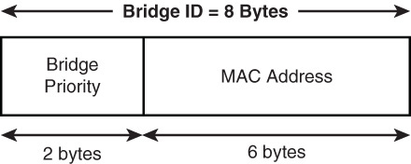
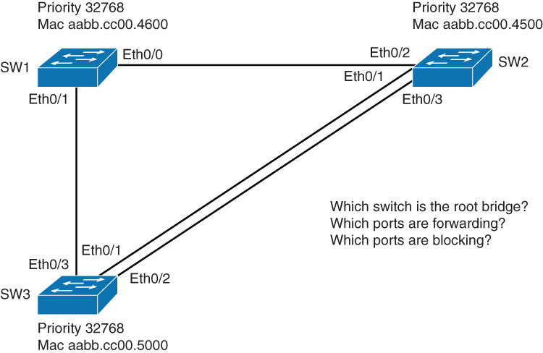
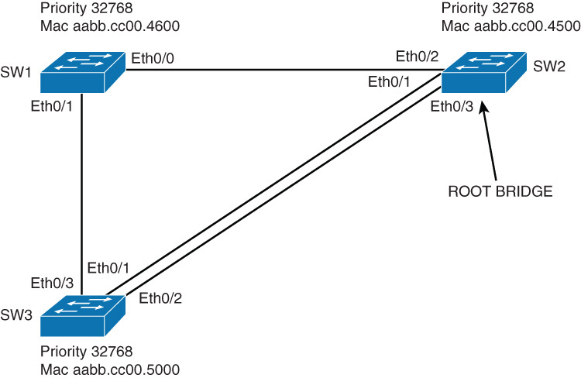
Root Bridge Election
The root bridge is chosen with an election. Each switch has an unique BID that consists of:
Bridge priority ( a value between 0 and 65,535, with the default 32,768)
MAC Address (System MAC address of the switch)
Lowest BID wins
If priority is the same lowest MAC wins

Slide 13
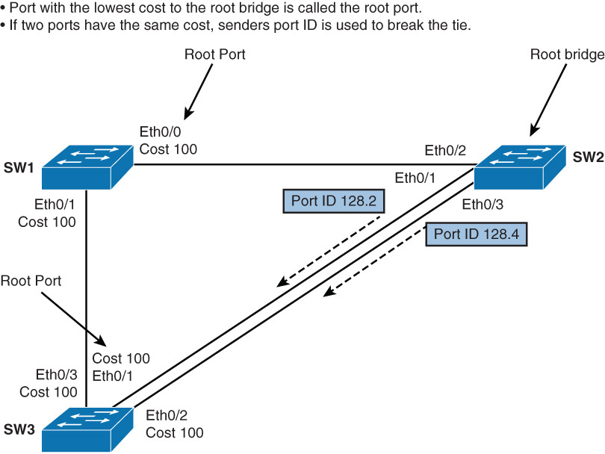
Root Port Election
Once the root bridge is elected, each nonroot bridge must figure out where it is in relation to the root bridge
Root port is the port with the best path (lowest cost) to the root bridge
Determined by cummulative path cost of all links to the root bridge
STP cost is calculated from the bandwidth of the link:
If two ports have the same cost, sender port ID is used to break the tie
Link | Cost
10 Gbps | 1
1 Gbps | 4
100 Mbps | 19
10 Mbps | 100

Slide 14
Designated Port Election
After the root bridge and root ports on non-root bridges have been elected, to prevent the loops STP has to identify which port on the segment will forward the traffic.
Only one of the links on a segment should forward traffic to and from that segment.
The designated port, the one forwarding the traffic, is also chosen based on the lowest cost the root bridge.
On the root bridge, all ports are designated.
If two paths have equal costs the following criteria is used:
lowest root BID
lowest root path cost to root bridge
lowest sender BID
lowest sender port ID

Slide 15
STP Process
Notes:
Explain everything

Slide 16
STP Port States
To participate in the spanning-tree process, a switch port must go through several states.
A port starts in the disabled state, then after an administrator enables it, goes through various states until it reaches the forwarding state.

Slide 17
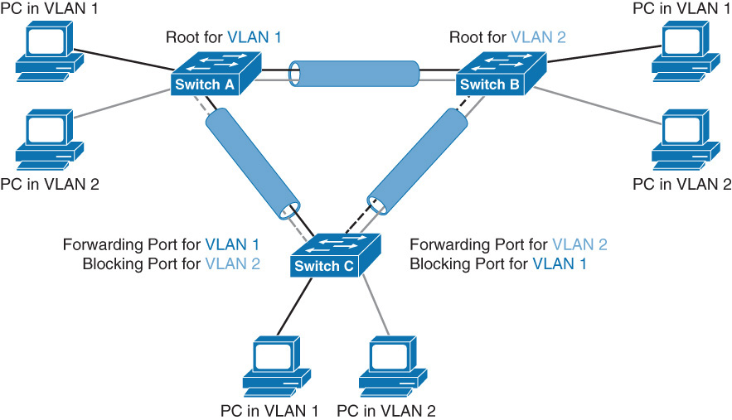
Per VLAN STP Plus (PVST+)
Unlike CST,PVST+ runs one spanning-tree instance for each VLAN.
This allows you to load balanced traffic over redundant links when they're assigned to a different VLAN.

Slide 18
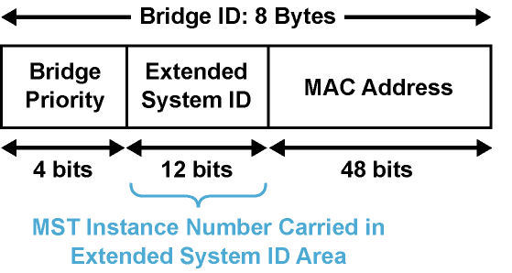
PVST+ Use of Extended System ID
PVST+ uses the extended system ID to carry the
VLAN ID+
PVST+ carries the VLAN ID in the 12-bit Extended System ID field of the Bridge ID.
Since the bridge priority field has been reduced to 4 bits, the priority is in increments of 4096
The bridge ID shows the actual priority plus the VLAN ID, thus VLAN 1 with a default priority of 32,768 will show a priority of 32,769

Slide 19
STP Topology Changes
When a switch moves a port into the forwarding state or into blocking state, that means an STP topology changes.
The switch announces a topology change by sending a TCN BPDU out from the root port.
This BPDU does not contain data about the change, but it only informs other switches in the network that the change has occurred.
When the root bridge receives the TCN BPDU, it first sends an acknowledgement BPDU topology change acknowledgement (TCA) to the switch from which it receives the TCN.
The root bridge then signals the topology change to other switches in the network by changing topology change flag in its BPDU (TC)
Switches then shorten the bridge table ageing times to the forward delay time.

Slide 20
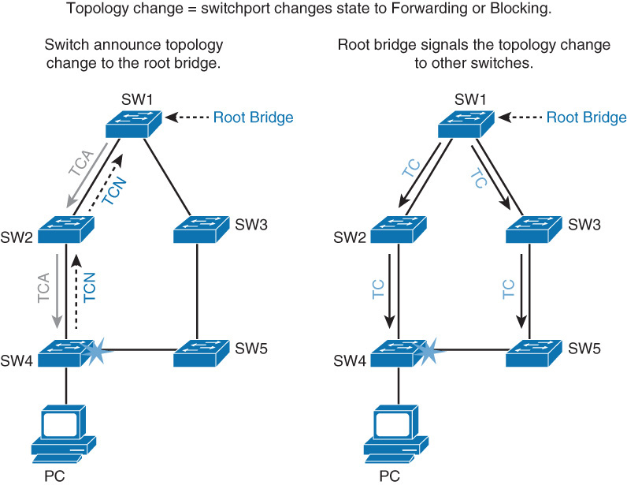
STP Topology Changes

Slide 21

Rapid Spanning Tree Protocol

Slide 22
Rapid Spanning Tree Protocol
Rapid Spanning Tree Protocol (IEEE 802.1w (2001)), also referred to as RSTP) significantly speeds the recalculation of the spanning tree when the network topology changes.
RSTP defines the additional port roles of Alternate and Backup and defines port states as discarding, learning, or forwarding.
802.1D STP standard was designed with the understanding that recovering connectivity after an outage within a minute or so gives adequate performance
Cisco enhanced the original 802.1D specification with features such as UplinkFast, BackboneFast, and PortFast to speed up the convergence time of a bridged network.
The drawback is that these mechanisms are proprietary and need additional configuration. The IEEE 802.1w standard (RSTP) is an evolution, rather than a revolution, of the 802.1D standard.
Notes:
Rapid Spanning Tree Protocol (IEEE 802.1w, also referred to as RSTP) significantly speeds the recalculation of the spanning tree when the network topology changes.
RSTP defines the additional port roles of Alternate and Backup and defines port states as discarding, learning, or forwarding. 802.1D STP standard was designed with the understanding that recovering connectivity after an outage within a minute or so gives adequate performance. With the advent of Layer 3 switching in LAN environments, bridging now competes with routed solutions, in which protocols such as Open Shortest Path First (OSPF) and Enhanced Interior Gateway Routing Protocol (EIGRP) can provide an alternative path in approximately 1 second.
Cisco enhanced the original 802.1D specification with features such as UplinkFast, BackboneFast, and PortFast to speed up the convergence time of a bridged network. The drawback is that these mechanisms are proprietary and need additional configuration. The IEEE 802.1w standard (RSTP) is an evolution, rather than a revolution, of the 802.1D standard. The 802.1D terminology remains primarily the same, and most parameters are left unchanged, so users who are familiar with 802.1D can rapidly feel at home when configuring the new protocol.

Slide 23
Rapid Spanning Tree Protocol
In most cases, RSTP performs better than the Cisco proprietary extensions, with negligible additional configuration.
In addition, 802.1w can revert to 802.1D to interoperate with legacy bridges on a per-port basis.
RSTP provides rapid connectivity following the failure of a switch, switch port, or LAN.
A new root port and the designated port of the connecting bridge transition to forwarding through an explicit handshake protocol between them.
RSTP enables switchport configuration so that the ports transition to forwarding directly when the switch reinitializes.
On Cisco Catalyst switches, a rapid version of PVST+, called PVRST+, is the per-VLAN version of the RSTP implementation. All of the current generation of Catalyst switches support PVRST+..

Slide 24
RSTP Port Roles
RSTP defines the following port roles :
Root
The root port is the switch port on every nonroot bridge that is the chosen path to the root bridge.
There can be only one root port on every switch.
The root port is considered as part of active topology.
It forwards, sends, and receives BPDUs (data messages).
Designated
Each switch has at least one switch port as the designated port for the segment.
In active topology, the switch with the designated port receives frames on the segment that are destined for the root bridge.
There can be only one designated port per segment.

Slide 25
RSTP Port Roles
RSTP defines the following port roles :
Alternate
The alternate port is a switch port that offers an alternate path toward the root bridge.
It assumes a discarding state in an active topology.
The alternate port makes a transition to a designated port if the current designated path fails.
Backup
The backup port is an additional switch port on the designated switch with a redundant link to the shared segment for which the switch is designated.
The backup port has the discarding state in active topology.
Disabled
A disabled port has no role within the operation of spanning tree.

Slide 26
RSTP Operation – Port Roles
STP Port Role | RSTP Port Role | STP Port State | RSTP Port State
Root port | Root port | Forwarding | Forwarding
Designated port | Designated port | Forwarding | Forwarding
Nondesignated port | Alternate or backup port | Blocking | Discarding
Disabled | Disabled | - | Discarding
Transition | Transition | Listening Learning | Learning
Notes:
The port role defines the ultimate purpose of a switch port and the way it handles data frames. One strength of RSTP is that port roles and port states can transition independently of each other. RSTP defines the port roles as follows:
Root: The root port is the switch port on every nonroot bridge that is the chosen path to the root bridge. Only one root port can be on every switch. The root port assumes the forwarding state in a stable active topology. In the figure, the root port is marked as R.
Designated: Each segment has at least one switch port as the designated port for that segment. In a stable, active topology, the switch with the designated port receives frames on the segment that are destined for the root bridge. There can be only one designated port per segment. The designated port assumes the forwarding state. All switches that are connected to a given segment listen to all BPDUs and determine the switch that will be the designated switch for a particular segment. In the figure, the designated port is marked as D.
Alternate: The alternate port is a switch port that offers an alternate path toward the root bridge. The alternate port assumes a discarding state in a stable, active topology. An alternate port is present on nondesignated switches and makes a transition to a designated port if the current designated path fails. In the figure, the alternate port is marked as A.
Backup: The backup port is an additional switch port on the designated switch with a redundant link to the segment for which the switch is designated. A backup port has a higher port ID than the designated port on the designated switch. The backup port assumes the discarding state in a stable, active topology. In the figure, the backup port is marked as B.
Disabled: A port that has no role within the operation of spanning tree.
Root and designated port roles include the port in the active topology. Alternate and backup port roles exclude the port from the active topology. Table 3-5 compares the 802.1D port role and the RSTP port roles. Establishing the additional port roles allows RSTP to define a standby switch port before a failure or topology change. The alternate port moves to the forwarding state if a failure occurs on the designated port for the segment.

Slide 27
RSTP Operation – Port States
Port State | Description
Discarding | This state is seen in both a stable active topology and during topology synchronization and changes. The discarding state prevents the forwarding of data frames, thus “breaking” the continuity of a Layer 2 loop.
Learning | This state is seen in both a stable active topology and during topology synchronization and changes. The learning state accepts data frames to populate the MAC table to limit flooding of unknown unicast frames.
Forwarding | This state is seen only in stable active topologies. The forwarding switch ports determine the topology. Following a topology change, or during synchronization, the forwarding of data frames occurs only after a proposal and agreement process.
Operational Status | STP Port State | RSTP Port State | Port Included in Active Topology
Enabled | Blocking | Discarding | No
Enabled | Listening | Discarding | No
Enabled | Learning | Learning | Yes
Enabled | Forwarding | Forwarding | Yes
Disabled | Disabled | Discarding | No
Notes:
RSTP has only three port states, corresponding to the three possible operational statuses: discarding, learning, and forwarding. The RSTP 802.1w discarding state represents a merger of the 802.1D STP port states of disabled, blocking, and listening
IEEE 802.1D STP mixes the state of a port, whether blocking or forwarding traffic, with the role it plays in the active topology (root port, designated port, and so on). For example, from an operational point of view, there is no difference between a port in the blocking state and a port in the listening state. Both discard frames and do not learn MAC addresses. The real difference lies in the role the spanning tree assigns to the port. It can safely be assumed that a listening port is either designated or root and is on its way to the forwarding state. Unfortunately, when in the forwarding state, there is no way to infer from the port state whether the port is root or designated. RSTP considers there to be no difference between a port in blocking state and a port in listening state; both discard frames, and neither learns MAC addresses. RSTP decouples the role of a port from the state of a port. In all port states, a port will accept and process BPDU frames. The table above provides a comparison of 802.1D port states with RSTP port states.

Slide 28
RSTP Topology Changes
With RSTP, the TC propagation is now a one-step process. In fact, the initiator of the topology change floods this information throughout the network, as opposed to 802.1D, where only the root did.
This mechanism is much faster than the 802.1D equivalent.
In just a few seconds, or a small multiple of hello times, most of the entries in the CAM tables of the entire network (VLAN) flush.
Why does RSTP not consider link failure a topology change?
Loss of connectivity does not provide new paths in topology. If a switch loses the link to a downstream switch, the downstream switch either has an alternate path to the root bridge or it does not.
If the downstream switch has no alternate path, no action will be taken to improve convergence.
If the downstream switch has an alternate path, the downstream switch will unblock it and consequently generate its own BPDUs with the TC bit set.
Like with STP, PortFast-enabled ports do not create topology changes.
Notes:
When a switch receives a BPDU with TC bit set from a neighbor, it clears the MAC addresses learned on all its ports except the one that receives the topology change.
The switch also receives BPDUs with the TC bit set on all designated ports and the root port.
RSTP no longer uses the specific TCN BPDUs unless a legacy bridge needs to be notified.

Slide 29
RSTP and 802.1D STP Compatibility
RSTP can operate with 802.1D STP. However, 802.1w’s fast-convergence benefits are lost when interacting with 802.1D bridges.
Each port maintains a variable that defines the protocol to run on the corresponding segment. If the port receives BPDUs that do not correspond to its current operating mode for two times the hello time, it switches to the other STP mode.

Slide 30
Default STP Configuration on Cisco Switch
PVST+ (depends on switch) most modern IOS PVRST+
In lab 3650 defaults to PVRST+
2960 defaults to PVST+ indicated by protocol IEEE
Bridge priority 32,768 for each VLAN + VLAN number
Notes:
Cisco Catalyst switches support three types of spanning tree:
PVST+
PVRST+
MST
The default spanning tree mode for Cisco Catalyst switches is PVST+. In this mode, a separate STP instance runs for each VLAN. The direct consequence is that, as the STP calculation is done the same way for each VLAN, the same switch becomes root bridge for all VLANs. Each change of topology has exactly the same impact on all VLANs. Redundant links are blocked the same way, at the same location of the network. There is no load sharing between redundant links in this configuration.

Slide 31
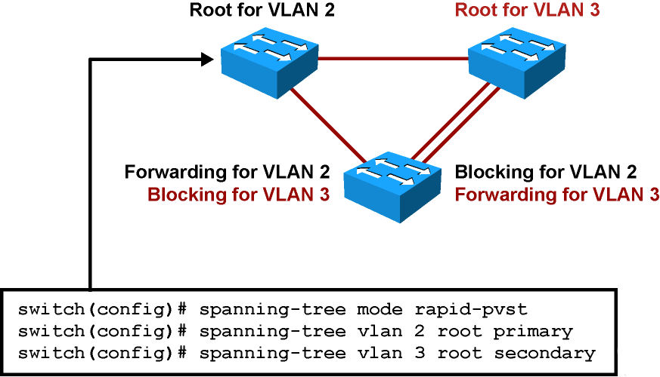
Implementing PVRST+
Enable PVRST+ globally. PVRST+ should be configured on all switches in the broadcast domain.
Designate and configure a switch to be the root bridge.
Designate and configure a switch to be the secondary (backup) root bridge.
Ensure load sharing on uplinks using priority and cost parameters.
Verify the configuration.

Slide 32
Verifying PVRST+
The output below illustrates how to verify the RSTP configuration for VLAN2 on a nonroot switch in a topology.
Switch# show spanning-tree vlan 2
VLAN0002
Spanning tree enabled protocol rstp
Root ID Priority 32768
Address 000b.fcb5.dac0
Cost 38
Port 7 (FastEthernet0/7)
Hello Time 2 sec Max Age 20 sec Forward Delay 15 sec
Bridge ID Priority 32770 (priority 32768 sys-id-ext 2)
Address 0013.5f1c.e1c0
Hello Time 2 sec Max Age 20 sec Forward Delay 15 sec
Aging Time 300
Interface Role Sts Cost Prio.Nbr Type
---------------- ---- --- -------- -------- -----------------
Fa0/7 Root FWD 19 128.7 P2p
Fa0/8 Root FWD 19 128.8 P2p

Slide 33
Changing STP Priority
It is not advised for the network to choose the root bridge by itself. If all switches have default STP priorities, the switch with the lowest MAC address will become the root bridge.
The oldest switch will have the lowest MAC address because the lower MAC addresses were factory-assigned first.
To manually set the root bridge, you can change a switch’s priority
Note
It is highly recommended to configure the distribution or core switches to become the root bridge.

Slide 34
Changing STP Priority
The priority can be a value between 0 and 65,535, in increments of 4096. The default value is 32,768.
The better solution is to use spanning-tree vlan vlan-id root { primary | secondary } command.
This command is actually a macro that lowers the switch’s priority number for it to become the root bridge.
To configure the switch to become the root bridge for a specified VLAN, use the primary keyword.
Use the secondary keyword to configure a secondary root bridge.
The spanning-tree root command calculates the priority by learning the current root priority and lowering the 4096 value to it.
Notes:
Note If the priority of the root bridge is set to 0, configuring another switch with the root primary command will yield no results. The command will fail because it cannot make a local switch priority for 4096 lower than that of the root bridge.

Slide 35
STP Path Manipulation
For port role determination, the cost value is used.
If all ports have the same cost, the sender’s port ID breaks the tie.
To control active port selection, change the cost of the interface or sender’s interface priority.
Port cost can be modified by using the spanning-tree vlan vlan-list cost cost-value command. The cost value can be between 1 and 65,535
You are telling the switch “add” this value to the INCOMING advertised cost of received BPDUs (i.e change the value to the modified cost).
The port ID consists of a port priority and a port number. The port number is fixed, but you can change the port priority
Port priority can be modified by using the spanning-tree vlan vlan-list port-priority port-priority command. The value can be between 0 and 255. the default is 128. A lower port priority means a more preferred path to the root bridge
Lowering the port priority on a switch will cause the switch to ADVERTISE a lower value to its neighbor.

Slide 36
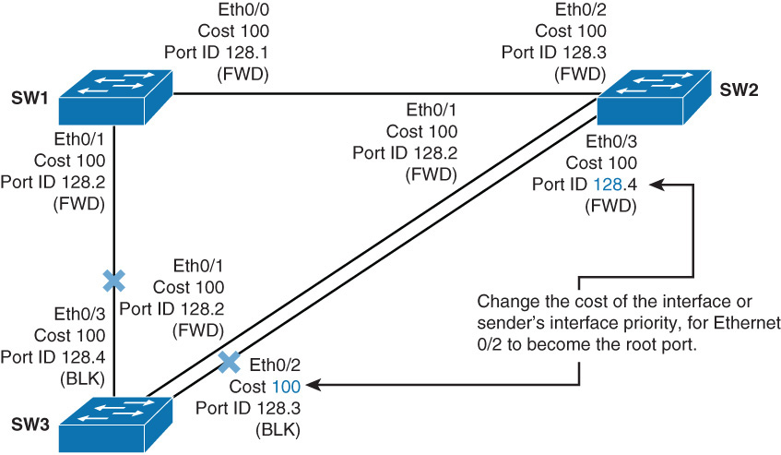
STP Path Manipulation
On SW3 Ethernet 0/1 and Ethernet 0/2 have the same interface STP cost
Ethernet 0/1 is forwarding because its sender’s port ID (128.2) is lower than that of Ethernet 0/3 (128.4)
To change SW3 to use Ethernet 0/2 we can change the port cost
SW3(config)# interface Ethernet 0/2
SW3(config-if)# spanning-tree vlan 1 cost 16

Slide 37
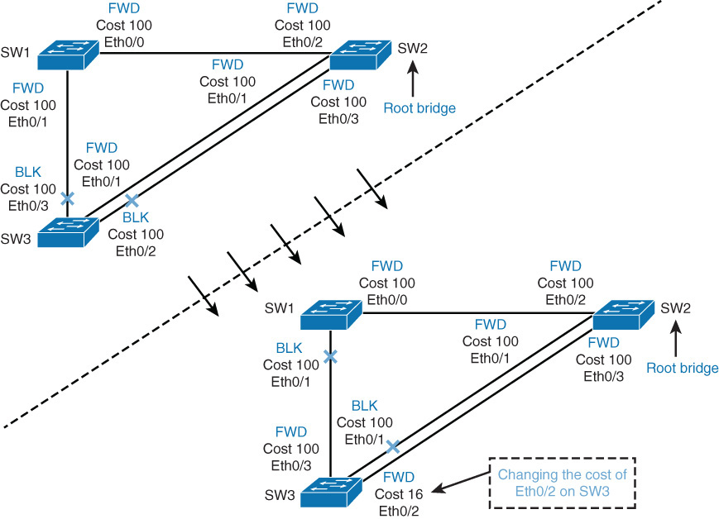
STP Path Manipulation Before and After

Slide 38
STP Timers
STP uses three different timers to ensure proper loop-free convergence. The three key STP timers and their default values are as follows:
Hello time
The time between each BPDU that is sent on a port. Equals 2 seconds, by default.
Forward delay
The time that is spent in the listening and learning state. Equals 15 seconds, by default.
Max (maximum) age
Controls the maximum length of time that passes before a bridge port saves its configuration BPDU information. Equals 20 seconds, by default.

Slide 39
STP Timers
The transition between port states takes from 30 to 50 seconds, depending on the topology change.
This can be adjusted with STP timers. STP hello time can be tuned between 1 and 10 seconds, forward delay between 4 and 30 seconds, and maximum age between 6 and 40 seconds.
To manually configure timers, use the spanning-tree [ vlan vlan-id ] { hello-time | forward-time | max-age } seconds command.

Slide 40

Implementing STP Stability Mechanisms
Notes:
STP is a mature protocol, benefiting from years of development and production deployment; however, STP makes assumptions about the quality of the network and it can fail. Those failures are generally high profile failures because of the extent to which they impact the network. STP is designed to never open, even temporarily, a loop during its operation. However, like any protocol, it is based on some assumptions that might not be valid in the network. To help STP converge faster and for the protocol behavior to match your network infrastructure, several features are available to filter the way Bridge Protocol Data Units (BPDU) are sent or received, and to alter the way the network should react if an unexpected network topology change occurs. 802.1D does not prevent unwanted devices from becoming the root bridge of the spanning tree, and no mechanism exists to selectively discard BPDUs from certain ports. The Cisco STP toolkit provides tools to better manage STP. Features such as Root Guard and BPDU Guard solve the problem of unauthorized or inappropriate devices causing network topology changes.
In addition, network device failures can cause bridging loops or black holes in the network. The Cisco Unidirectional Link Detection (UDLD) and loop guard features prevent network device failures that are due to faulty hardware or software errors. Problems such as link duplex mismatch, unidirectional link failure, frame corruption, resource errors, and misconfigurations can disrupt the spanning tree, which in turn disrupts network traffic. As a result, understanding how to troubleshoot spanning-tree problems is critical in maintaining high network availability. The following best practices for spanning tree prevent problems and aid in quick network recovery if unforeseen anomalous events occur. This remaining section of this chapter introduces the STP enhancements with sample configurations. This section also discusses how to tune STP for higher availability and resiliency. STP does not provide for checks and balances to ensure high availability in multilayer switched networks.

Slide 41
Implementing STP Stability Mechanisms
The Cisco Spanning Tree Protocol Toolkit provides tools to better manage STP. The key features of the Cisco STP toolkit that improve STP performance are as follows:
UplinkFast:
enables fast uplink failover on an access switch.
BackboneFast:
enables fast convergence in distribution or core layer when STP changes occur.
PortFast:
configures access port to transition directly to forwarding state.

Slide 42
Implementing STP Stability Mechanisms
Key features of the Cisco STP toolkit that ensure STP stability are as follows:
BPDU Guard:
disables the PortFast-enabled port if a BPDU is received.
BPDU Filter:
suppresses BPDUs on ports.
Root Guard:
prevents external switches from becoming roots.
Loop Guard:
Prevents an alternate port from becoming the designated port if no BPDUs are received.
PortFast, UplinkFast, and BackboneFast improve convergence times of non-RSPT

Slide 43
PortFast
When PortFast is enabled, the port transitions immediately from blocking to forwarding.
PortFast should be enabled on access layer switches where the hosts are connected.
An additional benefit of using PortFast is that TCN BPDUs are not sent when a switch port in PortFast mode goes up or down.
By default, PortFast is disabled on all switch ports.
You can configure PortFast in two ways: per port and globally.
If you configure PortFast globally, all ports that are configured as access ports automatically become PortFast enabled, and the port will immediately transition to forwarding.
If a port does receive a BPDU, the port will disable the portfast feature.
If you configure PortFast per port
If it receives a BPDU the port will disable the portfast feature.
Notes:
NOTA

Slide 44
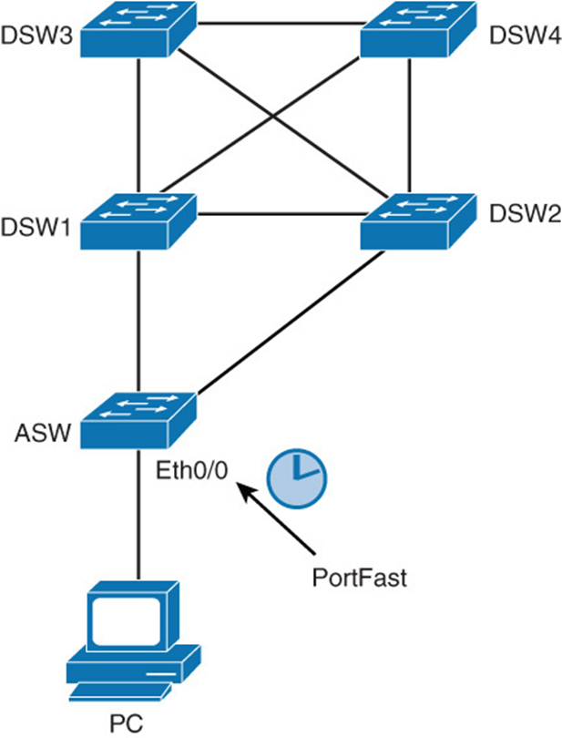
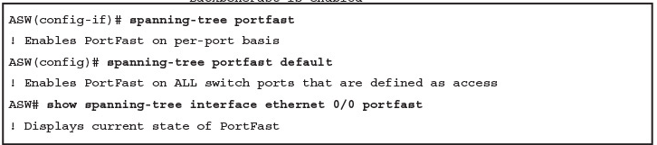
Configuring PortFast on Access Ports
Use the spanning-tree portfast interface command to enable the PortFast feature on the specified interfaces.
Use the spanning-tree portfast default global configuration mode command to enable the PortFast feature on all nontrunking interfaces.

Slide 45
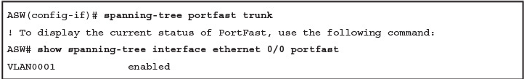
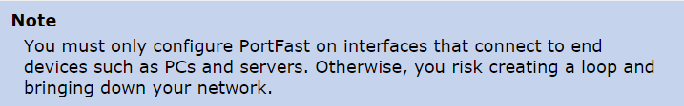
PortFast Configuration for a Trunk
Never use the PortFast feature on switch ports that connect to other switches, hubs, or routers.
You can also enable PortFast on trunk ports.
This is useful if you have a trunk enabled for a host such as a server that needs multiple VLANs.
To enable a port for PortFast on an interface that connects to such a server, use the following interface configuration commands:
Notes:
These connections can cause physical loops, and spanning tree must go through the full initialization procedure in these situations. A spanning-tree loop can bring your network down. If you turn on PortFast for a port that is part of a physical loop, there can be a window of time when packets are continuously forwarded (and can even multiply) in such a way that the network cannot recover.

Slide 46
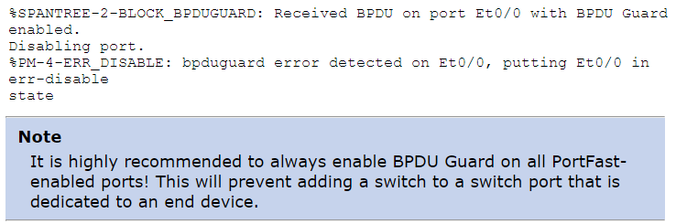
Securing PortFast Interface with BPDU Guard
BPDU Guard protects the integrity of ports that are PortFast enabled.
BPDU Guard puts an interface configured for STP PortFast in the err-disable state upon receipt of a BPDU.
BPDU guard disables interfaces as a preventive step to avoid potential bridging loops.
BPDU guard shuts down PortFast-configured interfaces that receive BPDUs, rather than putting them into the STP blocking state (the default behavior).
Notes:
Caution: Enabling BPDU filtering on an interface is the same as disabling spanning tree on it and can result in spanning-tree loop.

Slide 47
Securing PortFast Interface with BPDU Guard
PortFast-configured interfaces should not receive BPDUs. Reception of a BPDU by a PortFast-configured interface signals an invalid configuration, such as connection of an unauthorized device.
BPDU guard provides a secure response to invalid configurations, because the administrator must manually re-enable the err-disabled interface after fixing the invalid configuration.
It is also possible to set up a time-out interval after which the switch automatically tries to re-enable the interface. (errdisable recovery bpduguard)
However, if the invalid configuration still exists, the switch err-disables the interface again.
Notes:
Caution: Enabling BPDU filtering on an interface is the same as disabling spanning tree on it and can result in spanning-tree loop.

Slide 48
BPDU Guard Configuration
To enable BPDU guard globally, use the command:
ASW(config)# spanning-tree portfast bpduguard default
To enable BPDU guard on a port, use the command:
ASW(config-if)# spanning-tree bpduguard enable
BPDU guard logs messages to the console:
2009 May 12 15:13:32 %SPANTREE-2-RX_PORTFAST:Received BPDU on PortFast enable port.
Disabling 2/1
2009 May 12 15:13:32 %PAGP-5-PORTFROMSTP:Port 2/1 left bridge port 2/1
Note: it is highly recommended to always enable BPDU Guard on all PortFast –enabled ports! This will prevent adding a switch to a switch port that is dedicated to an end device.
Note: Global configurational is conditional: If the port is not Portfast enabled, BPDU Guard will not be activated.
Notes:
Note that on 6500 switches the global command is spanning-tree portfast edge bpduguard default .

Slide 49
BPDU Guard Configuration Example
Switch(config)# spanning-tree portfast default
Switch(config)# spanning-tree portfast bpduguard default
Switch(config)# end
Switch# show spanning-tree summary totals
Root bridge for: none.
PortFast BPDU Guard is enabled
Etherchannel misconfiguration guard is enabled
UplinkFast is disabled
BackboneFast is disabled
Default pathcost method used is short
Name Blocking Listening Learning Forwarding STP Active
------------ -------- --------- -------- ---------- ---------
34 VLANs 0 0 0 36 36
Note: Global configurational is conditional: If the port is not Portfast enabled, BPDU Guard will not be activated.

Slide 50
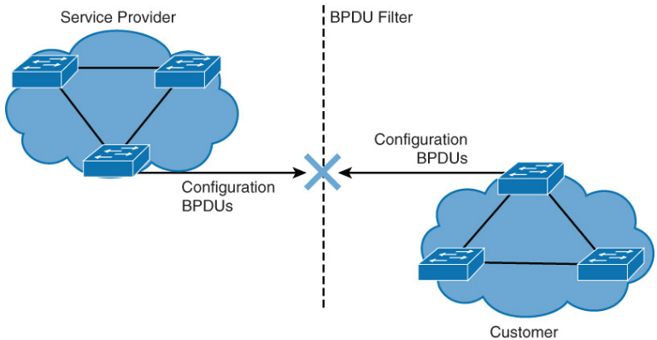
Disabling STP with BPDU Filter
BPDUs are sent on all ports, even if they are PortFast enabled.
You should always run STP to prevent loops.
However, in special cases, you need to prevent BPDUs from being sent out.
BPDU filtering prevents a Cisco switch from sending BPDUs on PortFast-enabled interfaces, preventing unnecessary BPDUs from being transmitted to host devices.
Configuring BPDU Filter, so that all configuration BPDUs received on a port are dropped can be useful for service provider environments, where a service provider provides Layer 2 Ethernet access for customers.
Notes:
Caution: Enabling BPDU filtering on an interface is the same as disabling spanning tree on it and can result in spanning-tree loop.

Slide 51
Disabling STP with BPDU Filter
BPDU guard has no effect on an interface if BPDU filtering is enabled.
When enabled globally, BPDU filtering has these attributes:
It affects all operational PortFast ports on switches that do not have BPDU filtering configured on the individual ports. It filters outgoing BPDUs
If incoming BPDUs are seen, the port loses its PortFast status, BPDU filtering is disabled, and STP sends and receives BPDUs on the port as it would with any other STP port on the switch.
Upon startup, the port transmits ten BPDUs. If this port receives any BPDUs during that time, PortFast and PortFast BPDU filtering are disabled.
When enabled on an interface, BPDU filtering has these attributes:
It ignores all BPDUs received.
It sends no BPDUs.
It is the same as disabling spanning tree on the interface

Slide 52
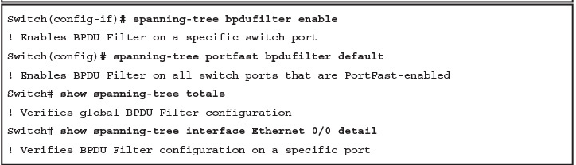
BPDU Filtering Configuration
To enable BPDU filtering globally, use the command:
spanning-tree portfast bpdufilter default
To enable BPDU guard on a port, use the command:
spanning-tree bpdufilter enable

Slide 53
Verifying BPDU Filtering Configuration (1)
PortFast BPDU filtering status:
Switch# show spanning-tree summary
Switch is in pvst mode
Root bridge for: none
Extended system ID is enabled
Portfast Default is disabled
PortFast BPDU Guard Default is disabled
Portfast BPDU Filter Default is enabled
Loopguard Default is disabled
EtherChannel misconfig guard is enabled
UplinkFast is disabled
BackboneFast is disabled
Configured Pathcost method used is short
Name Blocking Listening Learning Forwarding STP Active
------- ---- -------- ------- -------- ---------
VLAN0001 2 0 0 6 8
------- ---- -------- ------- -------- ---------
1 vlan 2 0 0 6 8

Slide 54
Verifying BPDU Filtering Configuration (2)
Verifying PortFast BPDU filtering on a specific port:
Switch# show spanning-tree interface fastEthernet 4/4 detail
Port 196 (FastEthernet4/4) of VLAN0010 is forwarding
Port path cost 1000, Port priority 160, Port Identifier 160.196.
Designated root has priority 32768, address 00d0.00b8.140a
Designated bridge has priority 32768, address 00d0.00b8.140a
Designated port id is 160.196, designated path cost 0
Timers:message age 0, forward delay 0, hold 0
Number of transitions to forwarding state:1
The port is in the portfast mode by portfast trunk configuration
Link type is point-to-point by default
Bpdu filter is enabled
BPDU:sent 0, received 0

Slide 55
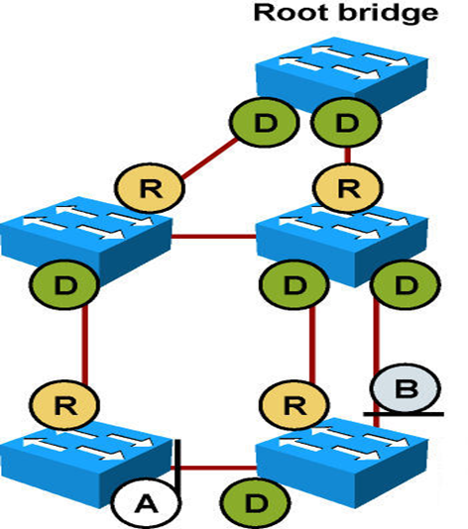
Root Guard
Root guard is useful in avoiding Layer 2 loops during network anomalies.
The Root guard feature forces an interface to become a designated port to prevent surrounding switches from becoming root bridges.
Root guard-enabled ports are forced to be designated ports.
If the bridge receives superior STP BPDUs on a Root guard-enabled port, the port moves to a root-inconsistent STP state, which is effectively equivalent to the STP listening state, and the switch does not forward traffic out of that port.
As a result, this feature enforces the position
of the root bridge.

Slide 56
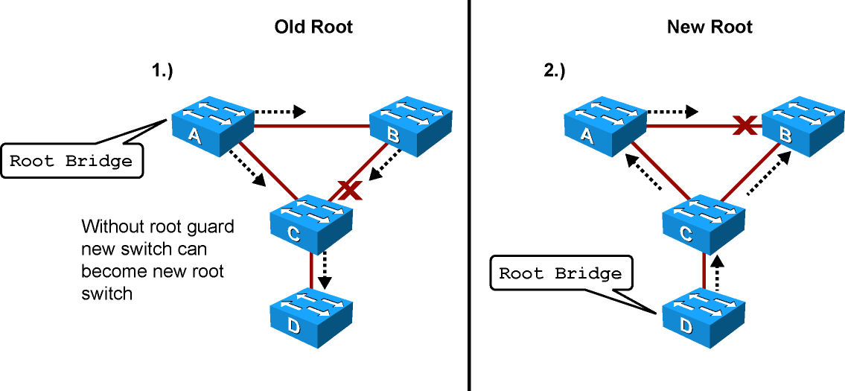
Root Guard Motivation
Switches A and B comprise the core of the network. Switch A is the root bridge.
Switch C is an access layer switch. When Switch D is connected to Switch C, it begins to participate in STP. If the priority of Switch D is 0 or any value lower than that of the current root bridge, Switch D becomes the root bridge.
Having Switch D as the root causes the Gigabit Ethernet link connecting the two core switches to block, thus causing all the data to flow via a 100-Mbps link across the access layer. This is obviously a terrible outcome.

Slide 57
Root Guard Operation
After the root guard feature is enabled on a port, the switch does not enable that port to become an STP root port.
Cisco switches log the following message when a root guard–enabled port receives a superior BPDU:
%SPANTREE-2-ROOTGUARDBLOCK: Port 1/1 tried to become non-designated in VLAN 77.
Moved to root-inconsistent state.

Slide 58
Root Guard Operation
Root Guard is used on designated ports, and it does not allow the port to become nondesignated.
In this configuration, Switch C blocks the port connecting to Switch D when it receives a superior BPDU. The port transitions to the root-inconsistent STP state. No traffic passes through the port while it is in root-inconsistent state.
When Switch D stops sending superior BPDUs, the port unblocks again and goes through regular STP transition of listening and learning, and eventually to the forwarding state. Recovery is automatic; no intervention is required.
Notes:
Enable Root Guard on Switches A, B, and C on the following ports:
Switch A (Distribution/Core): Any access port
Switch B (Distribution/Core): Any access port
Switch C (Access): Any access port including the port connecting to Switch D

Slide 59
Root Guard Configuration
Switch(config)# interface FastEthernet 5/8
Switch(config-if)# spanning-tree guard root
Switch(config-if)# end
Switch# show running-config interface FastEthernet 5/8
Building configuration...
Current configuration: 67 bytes
!
interface FastEthernet5/8
switchport mode access
spanning-tree guard root
End

Slide 60
Verifying Root Guard Configuration
Switch# show spanning-tree inconsistentports
Name Interface Inconsistency
-------------------- ---------------------- --------------
VLAN0001 FastEthernet3/1 Port Type Inconsistent
VLAN0001 FastEthernet3/2 Port Type Inconsistent
VLAN1002 FastEthernet3/1 Port Type Inconsistent
VLAN1002 FastEthernet3/2 Port Type Inconsistent
Number of inconsistent ports (segments) in the system :4
Notes:
Ports in root inconsistent recover automatically with no human intervention after the port stop receiving superior BPDUs. The port goes through the listening state to the learning state, and eventually transitions to the forwarding state.

Slide 61
Loop Guard
The Loop Guard STP feature improves the stability of Layer 2 networks by preventing forwarding bridging loops.
In STP, switches rely on continuous reception or transmission of BPDUs, depending on the port role. A designated port transmits BPDUs whereas a nondesignated port receives BPDUs.
Bridging loops occur when a port erroneously transitions to forwarding state because it has stopped receiving BPDUs.
Notes:
Prevention of forwarding loops and black holes in a network is a required aspect of network design. Black holes in the network are created when a device that receives frames has no forwarding information for that packet and thus essentially drops all such packets. Cisco Catalyst switches support two important features to address such conditions:
Loop Guard: The Loop Guard STP feature improves the stability of Layer 2 networks by preventing bridging loops.
UDLD: UDLD detects and disables unidirectional links.
If a switch receives a BPDU on a port in the loop-inconsistent STP state, the port transitions through STP states according to the received BPDU. As a result, recovery is automatic, and no manual intervention is necessary.

Slide 62
Loop Guard
Ports with loop guard enabled do an additional check before transitioning to forwarding state. If a nondesignated port stops receiving BPDUs, the switch places the port into the STP loop-inconsistent blocking state.
If a switch receives a BPDU on a port in the loop-inconsistent STP state, the port transitions through STP states according to the received BPDU. As a result, recovery is automatic, and no manual intervention is necessary.
Notes:
Prevention of forwarding loops and black holes in a network is a required aspect of network design. Black holes in the network are created when a device that receives frames has no forwarding information for that packet and thus essentially drops all such packets. Cisco Catalyst switches support two important features to address such conditions:
Loop Guard: The Loop Guard STP feature improves the stability of Layer 2 networks by preventing bridging loops.
UDLD: UDLD detects and disables unidirectional links.
If a switch receives a BPDU on a port in the loop-inconsistent STP state, the port transitions through STP states according to the received BPDU. As a result, recovery is automatic, and no manual intervention is necessary.

Slide 63
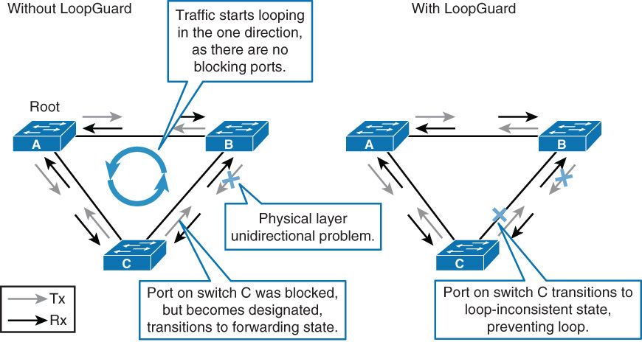
Loop Guard Messages
When the Loop Guard feature places a port into the loop-inconsistent blocking state, the switch logs the following message:
#SPANTREE-2-LOOPGUARD_BLOCK: LoopGuard blocking port FastEthernet 0/24 VLAN0050
After recovery, the switch logs the following message:
#SPANTREE-2-LOOPGUARD_UNBLOCK: LoopGuard unblocking port FastEthernet 0/24 VLAN0050

Slide 64
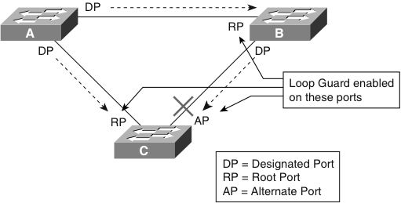
Loop Guard Configuration Considerations
Configure Loop Guard on a per-port basis, although the feature blocks inconsistent ports on a per-VLAN basis.
In the case of an EtherChannel interface, the channel status goes into the inconsistent state for all the ports belonging to the channel group for the particular VLAN not receiving BPDUs.
Enable Loop Guard on all nondesignated ports. Loop guard should be enabled on root and alternate ports for all possible combinations of active topologies.
Loop Guard is disabled by default on Cisco switches.

Slide 65
Loop Guard Configuration
Use the following interface-level configuration command to enable Loop Guard:
Switch(config-if)# spanning-tree guard loop
If Loop Guard is enabled globally, the switch enables Loop Guard only on ports considered to be point-to-point links (full-duplex links).
The global configuration can be overridden on a per-port basis. To enable Loop Guard globally, use the following global configuration command:
Switch(config)# spanning-tree loopguard default
Notes:
To disable loop guard on any specific interface on Cisco IOS–based Catalyst switches, issue the following interface configuration command: no spanning-tree loopguard. Disabling loop guard moves all loop-inconsistent ports to the listening state.

Slide 66
Verifying Loop Guard Configuration
To verify Loop Guard status on an interface, issue the command show spanning-tree interface interface-id detail.
Switch# show spanning-tree interface FastEthernet 3/42 detail
Port 170 (FastEthernet3/42) of VLAN0001 is blocking
Port path cost 19, Port priority 128, Port Identifier 128.170.
Designated root has priority 8193, address 0009.e845.6480
Designated bridge has priority 8193, address 0009.e845.6480
Designated port id is 128.160, designated path cost 0
Timers: message age 1, forward delay 0, hold 0
Number of transitions to forwarding state: 0
Link type is point-to-point by default
Loop guard is enabled on the port
BPDU: sent 1, received 4501

Slide 67
Loop Guard vs Root Guard
The Root Guard is mutually exclusive with the Loop Guard.
The Root Guard is used on designated ports, and it does not allow the port to become nondesignated.
The Loop Guard works on nondesignated ports and does not allow the port to become designated through the expiration of maximum age.
The Root Guard cannot be enabled on the same port as the Loop Guard.
When the Loop Guard is configured on the port, it disables the Root Guard configured on the same port.

Slide 68
Unidirectional Link Detection (UDLD)
Unidirectional links can cause spanning-tree topology loops.
Unidirectional Link Detection (UDLD) enables devices to detect when a unidirectional link exists and also to shut down the affected interface.
UDLD is useful on a fiber port to prevent network issues resulting in miswiring at the patch panel causing the link to be in up/up status but the BPDUs are lost.

Slide 69
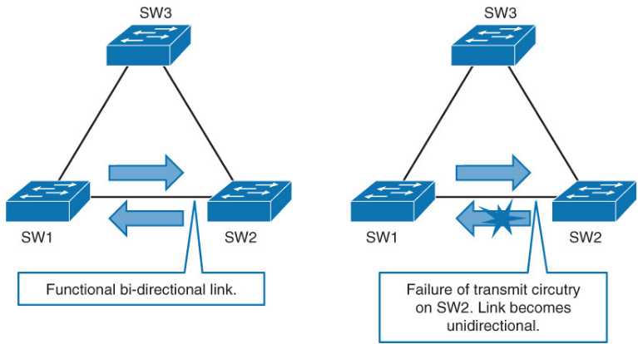
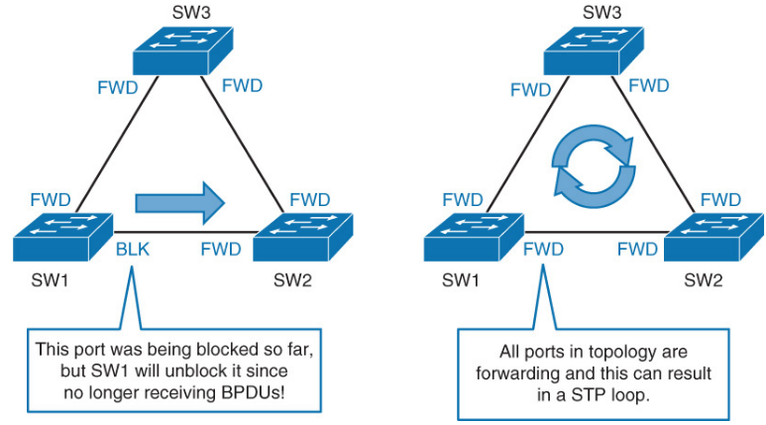
UDLD Overview

Slide 70
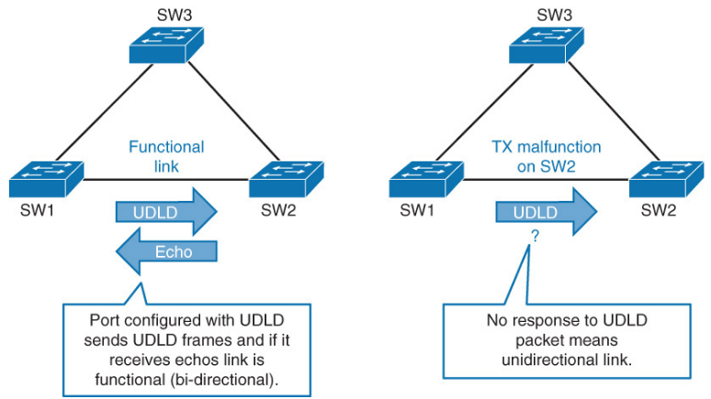
UDLD Overview
Notes:
Both UDLD peers discover each other by exchanging special frames that are sent to well-known MAC address 01:00:0C:CC:CC:CC
In an EtherChannel bundle, UDLD will error-disable only the physical link that has failed.

Slide 71
UDLD Overview
UDLD is a Layer 2 protocol that works with the Layer 1 mechanisms to determine the physical status of a link.
Both UDLD peers discover each other by exchanging special frames that are sent to well-known MAC address 01:00:0C:CC:CC:CC
In an EtherChannel bundle, UDLD will error-disable only the physical link that has failed.
UDLD messages are sent at regular intervals. This timer can be modified. The default setting varies between platforms. The typical value is 15 seconds.
UDLD is a Cisco proprietary protocol that is also defined in RFC 5171.

Slide 72
UDLD Operation
After UDLD detects a unidirectional link, it can take two courses of action, depending on configured mode. UDLD has two modes:
Normal mode
When a unidirectional link is detected, the port is allowed to continue its operation. UDLD just marks the port as having an undetermined state. A syslog message is generated.
Aggressive mode (Preferred)
When a unidirectional link is detected, the switch tries to reestablish the link. It sends one message a second, for 8 seconds. If none of these messages is sent back, the port is placed in error-disabled state.

Slide 73
UDLD Configuration
UDLD is disabled on all interfaces by default.
The udld global configuration command affects fiber-optic interfaces only.
udld enable enables UDLD normal mode on all fiber interfaces.
udld aggressive enables UDLD aggressive mode on all fiber interfaces.
The udld port interface configuration command can be used for twisted-pair and fiber interfaces.
To enable UDLD in normal mode, use the udld port command. To enable UDLD in aggressive mode, use the udld port aggressive.
Use the udld reset command to reset all the interfaces that were shut down by UDLD.
Notes:
UDLD is used when a link should be shut down because of a hardware failure that is causing unidirectional communication. In an EtherChannel bundle, UDLD shuts down only the physical link that has failed.
UDLD messages are sent every 60 seconds.
Use these commands to reset an interface shut down by UDLD:
The udld reset privileged EXEC command to reset all interfaces shut down by UDLD
The shutdown and no shutdown interface configuration commands
The no udld enable global configuration command followed by the udld {aggressive | enable} global configuration command to re-enable UDLD globally
The no udld port interface configuration command followed by the udld port or udld port aggressive interface configuration command to re-enable UDLD on the specified interface
The errdisable recovery cause udld and errdisable recovery interval interval global configuration commands to automatically recover from the UDLD error-disabled state.

Slide 74
Loop Guard versus Aggressive Mode UDLD
 | Loop Guard | Aggressive Mode UDLD
Configuration | Per port | Per port
Action granularity | Per VLAN | Per port
Auto-recovery | Yes | Yes, with err-disable timeout feature
Protection against STP failures caused by unidirectional links | Yes, when enabled on all root ports and alternate ports in redundant topology | Yes, when enabled on all links in redundant topology
Protection against STP failures caused by problem in software in designated bridge not sending BPDUs | Yes | No
Protection against miswiring | No | Yes
Notes:
Loop guard and aggressive mode UDLD functionality overlap insofar as both protect against STP failures caused by unidirectional links. These two features are different, however, in their approach to the problem and in functionality.
The most noticeable difference between aggressive mode UDLD and Loop Guard is with regard to STP. Aggressive mode UDLD cannot detect failures caused by problems in software in the designated switch not sending the BPDU. Problems resulting from software failures are less common than failures caused by unidirectional links that result from hardware failures. Nevertheless, aggressive mode UDLD is more robust in its capability to detect unidirectional links on EtherChannel. Loop Guard blocks all interfaces of the EtherChannel in such a failure by putting the EtherChannel into the loop-inconsistent state for a VLAN or for all VLANs, whereas aggressive mode UDLD disables the single port exhibiting problems. In addition, aggressive mode UDLD is not dependent on STP, so it supports Layer 3 links as well. In addition, Loop Guard does not support shared links or interfaces that are unidirectional on switch boot up. If a port is unidirectional on switch boot up, the port never receives BPDUs and becomes a designated port. Loop Guard does not support this scenario, because the behavior is not distinguishable from normal STP operation. Aggressive mode UDLD does provide protection against such a failure scenario.
Enabling both aggressive mode UDLD and Loop Guard provides the highest level of protection against bridging loops and black holes in multilayer switched networks.

Slide 75
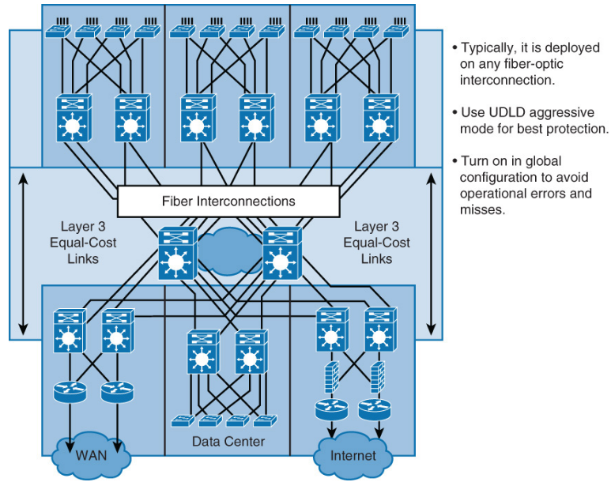
UDLD Recommended Practices

Slide 76
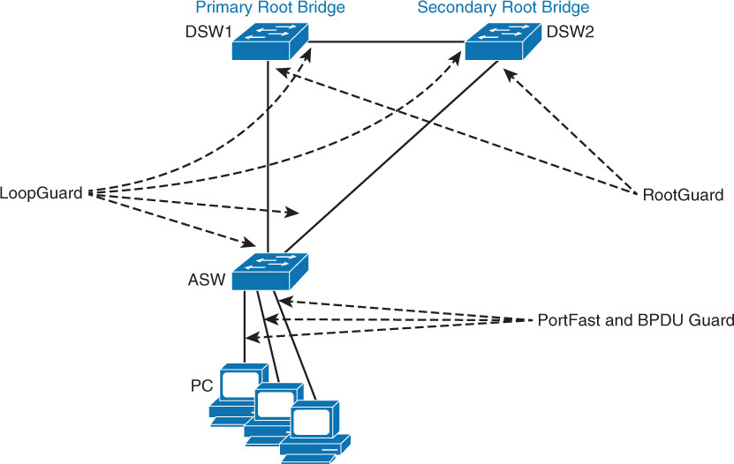
STP Stability Mechanisms Recommendations

Slide 77
Recommended Practices for STP Stability
PortFast: Apply to all end-user ports. To secure PortFast enabled ports, always combine PortFast with BPDU Guard
Root Guard: Apply to all ports where root is never expected.
Loop Guard: Apply to all ports that are or can become nondesignated.
UDLD: The UDLD protocol enables devices to monitor the physical configuration of the cables and detect when a unidirectional link exists. When a unidirectional link is detected, UDLD shuts down the affected LAN port. UDLD is often configured on port linking switches.
Note: The use of Root Guard and Loop Guard is mutually exclusive.
Depending on the security requirements of an organization, the port security feature can be used to restrict the ingress traffic of a port by limiting the MAC addresses that are allowed to send traffic into the port.

Slide 78
Multiple Spanning Tree

Slide 79
Multiple Spanning Tree
Multiple Spanning Tree (MST) extends the IEEE 802.1w RST algorithm to multiple spanning trees.
The main purpose of MST is to reduce the total number of spanning-tree instances to match the physical topology of the network.
Reducing the total number of spanning-tree instances will reduce the CPU loading of a switch.
The number of instances of spanning tree is reduced to the number of links (that is, active paths) that are available.
PVRST+ runs STP instances for each VLAN and does not take into consideration the physical topology that might not require many different STP topologies.
MST, on the other hand, uses a minimum number of STP instances to match the number of physical topologies present.
Notes:
Multiple Spanning Tree (MST) extends the IEEE 802.1w RST algorithm to multiple spanning trees. The main purpose of MST is to reduce the total number of spanning-tree instances to match the physical topology of the network and thus reduce the CPU cycles of a switch. PVRST+ runs STP instances for each VLAN and does not take into consideration the physical topology that might not require many different STP topologies. MST, on the other hand, uses a minimum number of STP instances to match the number of physical topologies present.

Slide 80
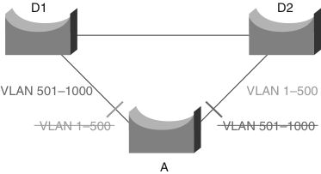
MST Motivation
Above: 2 links – 1000 VLANs – 2 MST instances.
Each switch maintains only two spanning trees, instead of maintaining 1000 spanning trees, thus reducing the need for switch resources.
Concept extendable to 4096 VLANs: VLAN load balancing.
MST converges faster than PVRST+ and is backward compatible with 802.1D STP and 802.1w.
Notes:
MST allows for the building of multiple spanning trees over trunks by grouping and associating VLANs to spanning-tree instances. Each instance may have a topology that is independent of other spanning-tree instances. This architecture provides multiple forwarding paths for data traffic and enables load balancing. A failure in one forwarding path does not affect other instances with different forwarding paths; hence, this architecture improves network fault tolerance. In large networks, using different VLANs and a different spanning-tree topology enables better administration of the network and use of the redundant paths available. An MST spanning-tree instance might exist only on bridges that have compatible VLAN instance assignments. Configuring a set of bridges with the same MST configuration information allows them to participate in a specific set of spanning-tree instances. The term MST region refers to the set of interconnected bridges that have the same MST configuration. The figure shows a common network design, featuring an access Switch A, connected to two Building Distribution submodule Switches D1 and D2. In this setup, there are 1000 VLANs, and the network administrator typically seeks to achieve load balancing on the access switch uplinks based on even or odd VLANs—or any other scheme deemed appropriate. Instead of creating 1000 PVRST+ instances, you can use MST with only two instances of spanning tree. The two ranges of VLANs are mapped to two MST instances, respectively. Rather than maintaining 1000 spanning trees, each switch needs to maintain only two.
Implementation of MST is not required if the Enterprise Campus Model is being employed because the number of active VLAN instances, and hence the STP instances, would be small and stable due to the design. In the scenario described in the figure, only two different final logical topologies exist and therefore require only two spanning-tree instances. There is no need to run 1000 instances if half of the 1000 VLANs map to a different spanning tree instance.

Slide 81
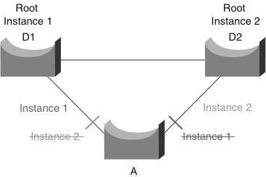
MST Instances
2 distinct final logical STP topologies exist, therefore require 2 MST instances (500 per instance here).
Load-balancing works because half of the VLANs follow each separate instance.
Switch utilization is low because it only has to handle two instances.
MST is the best solution for this scenario.
Considerations: MST is more complex than 802.1D and 802.1w, so it requires additional training. Interaction with legacy bridges can be challenging.
Notes:
MST enables you to build multiple spanning trees over trunks by grouping VLANs and associating them with spanning-tree instances. Each instance can have a topology independent of other spanning-tree instances. This architecture provides multiple active forwarding paths for data traffic and enables load balancing.
Network fault tolerance is improved over Common Spanning Tree (CST) because a failure in one instance (forwarding path) does not necessarily affect other instances.
This VLAN-to-MST grouping must be consistent across all bridges within an MST region. In large networks, you can more easily administer the network and use redundant paths by locating different VLAN and spanning-tree assignments in different parts of the network.
A spanning-tree instance can exist only on bridges that have compatible VLAN instance assignments. You must configure a set of bridges with the same MST configuration information, which allows them to participate in a specific set of spanning-tree instances. Interconnected bridges that have the same MST configuration are referred to as an (MST region. Bridges with different MST configurations or legacy bridges running 802.1D are considered separate MST regions.

Slide 82
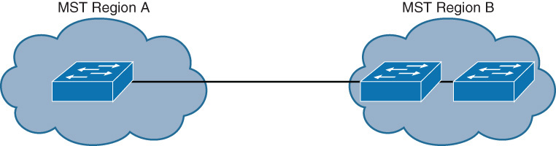
MST Regions
Each switch that runs MST in the network has a single MST configuration that consists of three attributes:
An alphanumeric configuration name (32 bytes)
A configuration revision number (2 bytes)
A 4096-element table that associates each of the potential 4096 VLANs supported on the chassis to a given instance
To be part of a common MST region, a group of switches must share the same configuration attributes.
It is the responsibility of the network administrator to propagate the configuration properly throughout the region
Notes:
The main enhancement introduced by MST is the ability to map several VLANs to a single spanning-tree instance. This raises the problem, however, of determining what VLAN is to be associated with what instance. More precisely, based on received BPDUs, devices need to identify these instances and the VLANs that are mapped to the instances. In the case of the 802.1Q standard, all instances map to a unique and common instance and are therefore less complex. In the case of PVST+, each VLAN carries the BPDUs for its respective instance (one BPDU per VLAN).
To be part of a common MST region, a group of switches must share the same configuration attributes. It is up to the network administrator to properly propagate the configuration throughout the region. To ensure a consistent VLANs-to-instance mapping, the protocol must exactly identify the boundaries of the regions. For that purpose, the characteristics of the region are included in BPDUs. Switches do not propagate the exact VLANs-to-instance mapping in the BPDU because the switches need to know only whether they are in the same region as a neighbor. Therefore, switches only send a digest of the VLANs-to-instance mapping table, along with the revision number and the name. When a switch receives a BPDU, it extracts the message digest, a numerical value derived from the VLANs-to-instance mapping table through a mathematical function, and compares it with its own computed digest. If the digests differ, the port receiving the BPDU is at the boundary of a region. In generic terms, a port is at the boundary of a region if the designated bridge on its segment is in a different region or if it receives legacy 802.1D BPDUs.

Slide 83
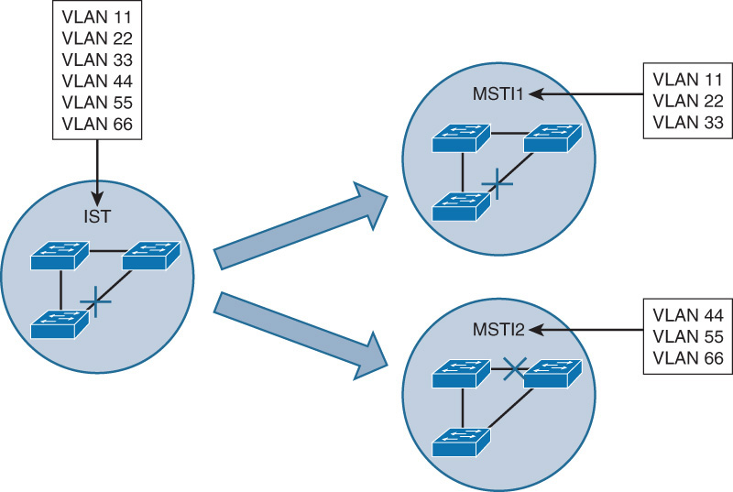
STP Instances with MST
MST does not send BPDUs for every active instance separately. A special instance (instance 0) is designated to carry all STP-related information.
BPDUs carry all the usual STP information, in addition to configuration name, revision number, and hash value that is calculated over VLAN-to-instance mapping tables.
If hash values do not match, an MST misconfiguration exists between the two switches.
On left, all six VLAN instances initially belong to MST0. This is the default behaviour
MST11 is created with VLANs 11, 22, and 33.
MST12 is created with VLANs 44, 55, and 66.
If different root bridges are configured, their topologies will converge differently, thus the links are more evenly utilized.

Slide 84
MST Use of Extended System ID
MST carries the instance number in the 12-bit Extended System ID field of the Bridge ID.

Slide 85
MST Configuration
Enable MST on switch.
Switch(config)# spanning-tree mode mst
Enter MST configuration submode.
Switch(config)# spanning-tree mst configuration
Display current MST configuration.
Switch(config-mst)# show current
Name MST instance.
Switch(config-mst)# name name
Set the 16-bit MST revision number. It is not incremented automatically when you commit a new MST configuration.
Switch(config-mst)# revision revision_number
Notes:
Enabling MST is a multistep process that involves mapping ranges of VLANs to a single MSTI. Because MST is applicable to multiple VLANs, it requires some additional configuration beyond that needed for PVRST+ after you enable MST.
Switch(config)# spanning-tree extend system-id is enabled by default This enables MAC address reduction, also known as extended system ID in Cisco IOS Software.
Switch(config-if)# spanning-tree mst pre-standard is required if the neighboring switch is using a prestandard version of MST.

Slide 86
MST Configuration (cont)
Map VLANs to MST instance.
Switch(config-mst)# instance instance_number vlan vlan_range
Display new MST configuration to be applied.
Switch(config-mst)# show pending
Apply configuration and exit MST configuration submode.
Switch(config-mst)# exit
Assign root bridge for MST instance. This syntax makes the switch root primary or secondary (only active if primary fails). It sets primary priority to 24576 and secondary to 28672.
Switch(config)# spanning-tree mst instance_number root primary | secondary

Slide 87
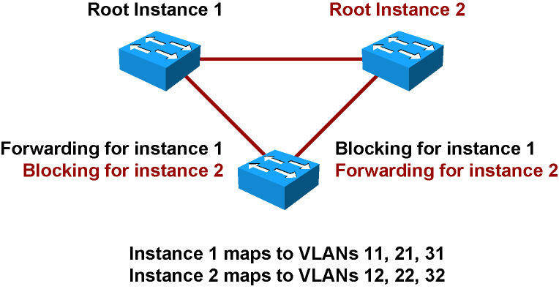
MST Configuration Example
SwitchA(config)# spanning-tree mode mst
SwitchA(config)# spanning-tree mst configuration
SwitchA(config-mst)# name XYZ
SwitchA(config-mst)# revision 1
SwitchA(config-mst)# instance 1 vlan 11, 21, 31
SwitchA(config-mst)# instance 2 vlan 12, 22, 32
SwitchA(config)# spanning-tree mst 1 root primary
SwitchB(config)# spanning-tree mode mst
SwitchB(config)# spanning-tree mst configuration
SwitchB(config-mst)# name XYZ
SwitchB(config-mst)# revision 1
SwitchB(config-mst)# instance 1 vlan 11, 21, 31
SwitchB(config-mst)# instance 2 vlan 12, 22, 32
SwitchB(config)# spanning-tree mst 2 root primary
Note: you must also configure SwitchC with MST as well
Notes:
Switch A is configured root for instance 1 and Switch B is configured root for instance 2, but the rest of the configuration, including name and VLAN grouping to instances, are identical.
The MST region is configured by mapping the appropriate VLANs to instances 1 and 2, respectively.

Slide 88
Verifying MST Configuration Example (1)
Switch# configure terminal
Enter configuration commands, one per line. End with CNTL/Z.
Switch(config)# spanning-tree mode mst
Switch(config)# spanning-tree mst configuration
Switch(config-mst)# show current
Current MST configuration
Name []
Revision 0
Instance Vlans mapped
-------- -----------------------------------------------------------
0 1-4094
---------------------------------------------------------------------
Switch(config-mst)# name cisco
Switch(config-mst)# revision 1
Switch(config-mst)# instance 1 vlan 1-10
Switch(config-mst)# show pending
Pending MST configuration
Name [cisco]
Revision 1
Instance Vlans mapped
-------- -----------------------------------------------------------
0 11-4094
1 1-10
Switch(config-mst)# end
Notes:
The show current command displays the current MST configuration on the switch. The show pending command details the uncommitted MST configuration. Catalyst switches discard the pending configuration if the administrator aborts the configuration changes by using the abort command. In addition, Catalyst switches save the MST configuration when issuing the end command.

Slide 89
Verifying MST Configuration Example (2)
Switch# show spanning-tree mst
###### MST00 vlans mapped: 5-4094
Bridge address 0009.e845.6480 priority 32768 (32768 sysid 0)
Root this switch for CST and IST
Configured hello time 2, forward delay 15, max age 20, max hops 20
Interface Role Sts Cost Prio.Nbr Type
---------------- ---- --- --------- -------- -------
Fa3/24 Desg FWD 2000000 128.152 Shr
Fa3/32 Desg FWD 200000 128.160 P2p
Fa3/42 Back BLK 200000 128.170 P2p
###### MST01 vlans mapped: 1-2
Bridge address 0009.e845.6480 priority 32769 (32768 sysid 1)
Root this switch for MST01
Interface Role Sts Cost Prio.Nbr Type
---------------- ---- --- --------- -------- -------
Fa3/24 Desg FWD 2000000 128.152 Shr
Fa3/32 Desg FWD 200000 128.160 P2p
Fa3/42 Back BLK 200000 128.170 P2p
###### MST02 vlans mapped: 3-4
Bridge address 0009.e845.6480 priority 32770 (32768 sysid 2)
Root this switch for MST02
Interface Role Sts Cost Prio.Nbr Type
---------------- ---- --- --------- -------- -------
Fa3/24 Desg FWD 2000000 128.152 Shr
Notes:
Use show spanning-tree mst to display MST protocol information for MSTI’s.

Slide 90
Verifying MST Configuration Example (3)
Switch# show spanning-tree mst 1
###### MST01 vlans mapped: 1-2
Bridge address 0009.e845.6480 priority 32769 (32768 sysid 1)
Root this switch for MST01
Interface Role Sts Cost Prio.Nbr Type
---------------- ---- --- ------ -------- -----------------
Fa3/24 Desg FWD 2000000 128.152 Shr
Fa3/32 Desg FWD 200000 128.160 P2p
Fa3/42 Back BLK 200000 128.170 P2p
Notes:
Use show spanning-tree mst # to display MST protocol information for a specific MST instance.

Slide 91
Verifying MST Configuration Example (4)
Switch# show spanning-tree mst interface FastEthernet 3/24
FastEthernet3/24 of MST00 is designated forwarding
Edge port: no (default) port guard : none (default)
Link type: shared (auto) bpdu filter: disable (default)
Boundary : internal bpdu guard : disable (default)
Bpdus sent 81, received 81
Instance Role Sts Cost Prio.Nbr Vlans mapped
-------- ---- --- ------- -------- -------------------------
0 Desg FWD 2000000 128.152 5-4094
1 Desg FWD 2000000 128.152 1-2
2 Desg FWD 2000000 128.152 3-4
Notes:
Use show spanning-tree mst interface FastEthernet 3/24 to display MST protocol information for the particular interface.

Slide 92
Verifying MST Configuration Example (5)
Switch# show spanning-tree mst 1 detail
###### MST01 vlans mapped: 1-2
Bridge address 0009.e845.6480 priority 32769 (32768 sysid 1)
Root this switch for MST01
FastEthernet3/24 of MST01 is designated forwarding
Port info port id 128.152 priority 128 cost 2000000
Designated root address 0009.e845.6480 priority 32769 cost 0
Designated bridge address 0009.e845.6480 priority 32769 port id 128.152
Timers: message expires in 0 sec, forward delay 0, forward transitions 1
Bpdus (MRecords) sent755, received 0
FastEthernet3/32 of MST01 is designated forwarding
Port info port id 128.160 priority 128 cost 200000
Designated root address 0009.e845.6480 priority 32769 cost 0
Designated bridge address 0009.e845.6480 priority 32769 port id 128.160
Timers: message expires in 0 sec, forward delay 0, forward transitions 1
Bpdus (MRecords) sent 769, received 1
FastEthernet3/42 of MST01 is backup blocking
Port info port id 128.170 priority 128 cost 200000
Designated root address 0009.e845.6480 priority 32769 cost 0
Designated bridge address 0009.e845.6480 priority 32769 port id 128.160
Timers: message expires in 5 sec, forward delay 0, forward transitions 0
Bpdus (MRecords) sent 1, received 769
Notes:
Use show spanning-tree mst # detail to display detailed protocol information for a given instance.

Slide 93
Configuring MST Path Cost
Path cost functions the same as with other STP's except with MST port costs are configured per instance.
MST, like any other STP, uses a sequence of four criteria to choose the best path:
Lowest BID
Lowest root path cost
Lowest sender BID
Lowest sender Port ID
You can assign lower cost values to the interfaces that you want selected first and higher cost values of that you want selected last.
Switch(config)# interface Ethernet 0/2
Switch(config-if)# spanning-tree mst 1 cost 100000

Slide 94
Configuring MST Port Priority
Port priority functions the same as with other STP's except with MST port priorities are configured per instance.
MST, like any other STP, uses the sequence of four criteria to choose the best path:
Lowest BID
Lowest root path cost
Lowest sender BID
Lowest sender Port ID
You can assign higher sender’s priority values (lower numeric values) to interfaces that you want selected first and lower sender’s priority values (higher numeric values) that you want selected last.
Switch(config)# interface Ethernet 0/2
Switch(config-if)# spanning-tree mst 1 port-priority 32

Slide 95
Troubleshooting STP
Notes:
Bridging loops generally characterize STP problems. Troubleshooting STP involves identifying and preventing such loops. The primary function of STP is to prevent loops created by redundant links in bridged networks. STP operates at Layer 2 of the OSI model. STP fails in specific cases, such as hardware or software anomalies. Troubleshooting these situations is typically difficult depending on the design of the network.

Slide 96
Potential STP Problems
Duplex mismatch
Unidirectional link failure
Frame corruption
Resource errors
PortFast configuration error

Slide 97
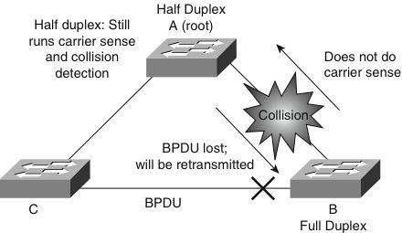
Duplex Mismatch
Point-to-point link.
One side of the link is manually configured as full duplex.
Other side is using the default configuration for auto-negotiation.
Notes:
The worst-case scenario for a duplex mismatch is when a bridge that is sending BPDUs is configured for half duplex on a link while its peer is configured for full duplex.
In the figure, the duplex mismatch on the link between Switch A and Switch B could potentially lead to a bridging loop. Because Switch B is configured for full duplex, it starts forwarding frames even if Switch A is already using the link. This is a problem for Switch A, which detects a collision and runs the back-off algorithm before attempting another transmission of its frame. If there is enough traffic from Switch B to Switch A, every packet (including the BPDUs) sent by Switch A is deferred or has a collision and is subsequently dropped.
From an STP point of view, because Switch B no longer receives BPDUs from Switch A, it assumes the root bridge is no longer present. Consequently, Switch B moves its port to Switch C into the forwarding state, creating a Layer 2 loop.

Slide 98
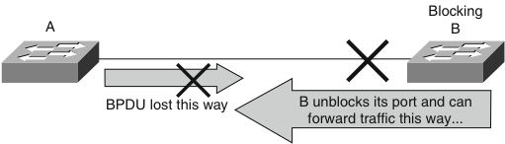
Unidirectional Link Failure
Frequent cause of bridge loops.
Undetected failure on a fiber link or a problem with a transceiver.
Notes:
With STP enabled to provide redundancy, any condition that results in a link maintaining a physical link connected status on both link partners but operating in a one-way communication state is detrimental to network stability because it could lead to bridging loops and routing black holes.
The figure shows such an example of a unidirectional link failure affecting STP. The link between Switch A and Switch B is unidirectional and drops traffic from Switch A to Switch B while transmitting traffic from Switch B to Switch A. Suppose, however, that the interface on Switch B should be blocking. An interface blocks only if it receives BPDUs from a bridge that has a better priority. In this case, all the BPDUs coming from Switch A are lost, and Switch B eventually moves to the forwarding state, creating a loop.
Note that in this case, if the failure exists at startup, STP does not converge correctly. In addition, rebooting of the bridges has absolutely no effect on this scenario. To resolve this problem, configure aggressive mode UDLD to detect incorrect cabling or unidirectional links and automatically put the affected port in err-disable state.
The general recommended practice is to use aggressive mode UDLD on all point-to-point interfaces in any multilayer switched network.

Slide 99
Frame Corruption
If an interface is experiencing a high rate of physical errors, the result may be lost BPDUs, which may lead to an interface in the blocking state moving to the forwarding state.
Uncommon scenario due to conservative default STP parameters.
Frame corruption is generally a result of a duplex mismatch, bad cable, or incorrect cable length.

Slide 100
Resource Errors
STP is performed by the CPU (software-based). This means that if the CPU of the bridge is over-utilized for any reason, it might lack the resources to send out BPDUs.
STP is generally not a processor-intensive application and has priority over other processes; therefore, a resource problem is unlikely to arise.
Exercise caution when multiple VLANs in PVST+ or PVRST+ mode exist. Consult the product documentation for the recommended number of VLANs and STP instances on any specific switch to avoid exhausting resources.

Slide 101
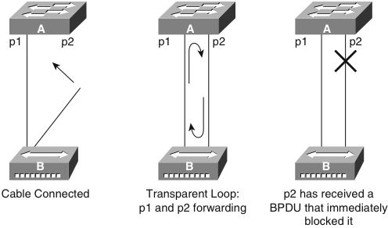
PortFast Configuration Error
Switch A has Port p1 in the forwarding state and Port p2 configured for PortFast. Device B is a hub. Port p2 goes to forwarding and creates a loop between p1 and p2 as soon as the second cable plugs in to Switch A. The loop ceases as soon as p1 or p2 receives a BPDU that transitions one of these two ports into blocking mode.
The problem with this type of transient loop condition is that if the looping traffic is intensive, the bridge might have trouble successfully sending the BPDU that stops the loop. BPDU guard prevents this type of event from occurring.

Slide 102
Troubleshooting Methodology
Troubleshooting STP issues can be difficult if logical troubleshooting procedures are not deployed in advance. Occasionally, rebooting of the switches might resolve the problem temporarily, but without determining the underlying cause of the problem, the problem is likely to return. The following steps provide a general overview of a methodology for troubleshooting STP:
Step 1. Develop a plan.
Step 2. Isolate the cause and correct an STP problem.
Step 3. Document findings.
Notes:
Develop a Plan
It is critical to develop a plan of action for potential STP issues. To create a plan, you must understand the following basic characteristics of your network:
Topology of the bridged network
Location of the root bridge
Location of the blocked ports and, therefore, the redundant linksunderstand the following basic characteristics of your network:
Knowing the basic characteristics is essential in troubleshooting any Layer 2 issue. In addition, knowledge of the network helps to focus attention on the critical ports on key devices, because most of the STP troubleshooting steps simply involve using show commands to identify error conditions. Knowing which links on each device is redundant helps to quickly stop a bridging loop by disabling those links.
Isolate the Cause and Correct an STP Problem
If there is a STP loop in your network, follow these steps:
Step 1. Identify a bridging loop.
Step 2. Restore connectivity.
Step 3. Check the port status.
Step 4. Check for resource errors.
Step 5. Disable unneeded features.
Identify a Bridging Loop
The best way to identify a bridging loop is to capture the traffic on a saturated link and to determine whether duplicate packets are propagating. If all users in a specific bridging domain have connectivity issues at the same time, a bridging loop is a possible cause. Check the port utilization on devices and look for abnormal values. In addition, you might see other protocols break down due to the bridging loops. For example, HSRP might complain of duplicate IP addresses if a loop causes it to see its own packets. Another common message during a loop is constant flapping of MAC addresses between interfaces. In a stable network, MAC addresses do not flap. In addition, be careful not to associate a bridging loop with a packet storm caused by another anomalous event such as an Internet worm or virus.
Restore Connectivity
Bridging loops have severe consequences on a bridged network. Administrators generally do not have time to look for the cause of a loop, however, preferring to restore connectivity as soon as possible and identify potential issues later. Restoring connectivity consists of the following two actions:
Breaking the loop: A simple solution is to manually disable every port that is providing redundancy in the network. Identify the part of the network that is more affected and start disabling ports in that area. If possible, start by disabling ports that should be in the blocking state. Check to see whether network connectivity is restored while disabling one port at a time.
Logging events: If it is not possible to identify the source of the problem or if the problem is transient, enable logging and increase the logging level of STP events on the switches experiencing the failure. At a minimum, enable logging on switches with blocked ports because the transition of a blocked port to forwarding state creates the loop. To log detailed events or to identify STP problems, use debug commands on Cisco IOS–based Catalyst switches. Debugging commands, if used with care, can help identify the source of the problem. Use the following command to enable STP debugging: debug spanning-tree events
Check Port Status
Investigate the blocking ports first and then the other ports. The following are several guidelines for troubleshooting port status:
Blocked ports: Check to make sure the switch reports receiving BPDUs periodically on root and blocked ports. Issue the following command on Cisco IOS–based Catalyst switches to display the number of BPDUs received on each interface: show spanning-tree vlan vlan-id detail Issue the command multiple times to determine whether the device is receiving BPDUs.
Duplex mismatch: To look for a duplex mismatch, check on each side of a point-to-point link. Simply use the show interface command to check the speed and duplex status of the specified ports.
Port utilization: An overloaded interface may fail to transmit vital BPDUs and is also an indication of a possible bridging loop. Use the show interface command to determine interface utilization using the load of the interface and packet input and output rates.
Frame corruption: Look for increases in the input error fields of the show interface command.
Look for Resource Errors
High CPU utilization can lead to network instability for switches running STP. Use the show processes cpu command to check whether the CPU utilization is approaching 100 percent. Cisco Catalyst switches prioritize control packets such as BPDU over any lowerpriority traffic; hence, the switch would be stable with higher CPU if it were just processing low-priority traffic. As a general rule of thumb, if the CPU exceeds 70 percent, action should be taken to rectify any problem or to consider re-architecting the network to prevent any potential future problems.
Disable Unneeded Features
Disabling as many features as possible reduces troubleshooting complexity. EtherChannel, for example, is a feature that bundles several different links into a single logical port. It might be helpful to disable this feature while troubleshooting. In general, simplifying the network configuration reduces the troubleshooting effort. If configuration changes are made during the troubleshooting effort, note the changes. An alternative way is to save the configuration by maintaining a copy of the configuring in bootflash or on a TFTP server. After the root cause is found and fixed, the removed configurations can be easily reapplied.
Document Findings
When the STP issue is isolated and resolved, it is important to document any learnings from the incident as part of improving the plan for future issues. Not documenting any configuration or network design changes to the previous plan might result in difficulty troubleshooting during the next STP issue. Documentation of the network is critical for eventual up time of the business. Significant amounts of outages can be prevented by planning ahead. In some cases, some links can be disabled to break the loop without impacting the business during business hours, and troubleshooting can be performed after-hours. Without clear documentation, the network will begin to affect all critical functions, and as network administrators, it is critical to have the proper documentation to reduce the time to stabilize the network. Documentation includes the IP addresses of all the devices, passwords, root and the secondary root, and the proper configuration of all switch to switch or switch to router links. Also knowing the network topology diagram with port number information can help determine quickly how the problem is manifested in the network. Having known good configuration is also essential to recover the network quickly.

Slide 103
Develop a Plan
It is critical to develop a plan of action for potential STP issues. To create a plan, you must understand the following basic characteristics of your network:
Topology of the bridged network
Location of the root bridge
Location of the blocked ports and, therefore, the redundant links
Understand the following basic characteristics of your network:
Knowing the basic characteristics is essential in troubleshooting any Layer 2 issue. In addition, knowledge of the network helps to focus attention on the critical ports on key devices, because most of the STP troubleshooting steps simply involve using show commands to identify error conditions. Knowing which links on each device is redundant helps to quickly stop a bridging loop by disabling those links.

Slide 104
Isolate the Cause, Correct the Problem
If there is a STP loop in your network, follow these steps:
Step 1. Identify a bridging loop.
Step 2. Restore connectivity.
Step 3. Check the port status.
Step 4. Check for resource errors.
Step 5. Disable unneeded features.
Notes:
Isolate the Cause and Correct an STP Problem
If there is a STP loop in your network, follow these steps:
Step 1. Identify a bridging loop.
Step 2. Restore connectivity.
Step 3. Check the port status.
Step 4. Check for resource errors.
Step 5. Disable unneeded features.
Identify a Bridging Loop
The best way to identify a bridging loop is to capture the traffic on a saturated link and to determine whether duplicate packets are propagating. If all users in a specific bridging domain have connectivity issues at the same time, a bridging loop is a possible cause. Check the port utilization on devices and look for abnormal values. In addition, you might see other protocols break down due to the bridging loops. For example, HSRP might complain of duplicate IP addresses if a loop causes it to see its own packets. Another common message during a loop is constant flapping of MAC addresses between interfaces. In a stable network, MAC addresses do not flap. In addition, be careful not to associate a bridging loop with a packet storm caused by another anomalous event such as an Internet worm or virus.
Restore Connectivity
Bridging loops have severe consequences on a bridged network. Administrators generally do not have time to look for the cause of a loop, however, preferring to restore connectivity as soon as possible and identify potential issues later. Restoring connectivity consists of the following two actions:
Breaking the loop: A simple solution is to manually disable every port that is providing redundancy in the network. Identify the part of the network that is more affected and start disabling ports in that area. If possible, start by disabling ports that should be in the blocking state. Check to see whether network connectivity is restored while disabling one port at a time.
Logging events: If it is not possible to identify the source of the problem or if the problem is transient, enable logging and increase the logging level of STP events on the switches experiencing the failure. At a minimum, enable logging on switches with blocked ports because the transition of a blocked port to forwarding state creates the loop. To log detailed events or to identify STP problems, use debug commands on Cisco IOS–based Catalyst switches. Debugging commands, if used with care, can help identify the source of the problem. Use the following command to enable STP debugging: debug spanning-tree events
Check Port Status
Investigate the blocking ports first and then the other ports. The following are several guidelines for troubleshooting port status:
Blocked ports: Check to make sure the switch reports receiving BPDUs periodically on root and blocked ports. Issue the following command on Cisco IOS–based Catalyst switches to display the number of BPDUs received on each interface: show spanning-tree vlan vlan-id detail Issue the command multiple times to determine whether the device is receiving BPDUs.
Duplex mismatch: To look for a duplex mismatch, check on each side of a point-to-point link. Simply use the show interface command to check the speed and duplex status of the specified ports.
Port utilization: An overloaded interface may fail to transmit vital BPDUs and is also an indication of a possible bridging loop. Use the show interface command to determine interface utilization using the load of the interface and packet input and output rates.
Frame corruption: Look for increases in the input error fields of the show interface command.
Look for Resource Errors
High CPU utilization can lead to network instability for switches running STP. Use the show processes cpu command to check whether the CPU utilization is approaching 100 percent. Cisco Catalyst switches prioritize control packets such as BPDU over any lowerpriority traffic; hence, the switch would be stable with higher CPU if it were just processing low-priority traffic. As a general rule of thumb, if the CPU exceeds 70 percent, action should be taken to rectify any problem or to consider re-architecting the network to prevent any potential future problems.
Disable Unneeded Features
Disabling as many features as possible reduces troubleshooting complexity. EtherChannel, for example, is a feature that bundles several different links into a single logical port. It might be helpful to disable this feature while troubleshooting. In general, simplifying the network configuration reduces the troubleshooting effort. If configuration changes are made during the troubleshooting effort, note the changes. An alternative way is to save the configuration by maintaining a copy of the configuring in bootflash or on a TFTP server. After the root cause is found and fixed, the removed configurations can be easily reapplied.

Slide 105
Document the Findings
When the STP issue is isolated and resolved, it is important to document any learnings from the incident as part of improving the plan for future issues.
Not documenting any configuration or network design changes to the previous plan might result in difficulty troubleshooting during the next STP issue
Notes:
Document Findings
When the STP issue is isolated and resolved, it is important to document any learnings from the incident as part of improving the plan for future issues. Not documenting any configuration or network design changes to the previous plan might result in difficulty troubleshooting during the next STP issue. Documentation of the network is critical for eventual up time of the business. Significant amounts of outages can be prevented by planning ahead. In some cases, some links can be disabled to break the loop without impacting the business during business hours, and troubleshooting can be performed after-hours. Without clear documentation, the network will begin to affect all critical functions, and as network administrators, it is critical to have the proper documentation to reduce the time to stabilize the network. Documentation includes the IP addresses of all the devices, passwords, root and the secondary root, and the proper configuration of all switch to switch or switch to router links. Also knowing the network topology diagram with port number information can help determine quickly how the problem is manifested in the network. Having known good configuration is also essential to recover the network quickly.

Slide 106
Resources
Cisco Spanning Tree Protocol Configuration Guide:
www.cisco.com/en/US/docs/switches/lan/catalyst3560/software/release/12.2_52_se/command/reference/3560cr.html
Configuring MST Configuration Guide:
www.cisco.com/en/US/docs/switches/lan/catalyst3560/software/release/12.2_52_se/configuration/guide/swstp.html
Cisco Optional Spanning-Tree Features Configuration Guide:
www.cisco.com/en/US/docs/switches/lan/catalyst3560/software/release/12.2_52_se/configuration/guide/swmstp.html
www.cisco.com/en/US/docs/switches/lan/catalyst3560/software/release/12.2_52_se/configuration/guide/swstpopt.html

Slide 107


